Slide 1
SQL Day 9

Slide 2
OFFSET
The OFFSET argument is used to identify the starting point to return rows from a result set. Basically, it exclude the first set of records.
it ignores the initial set of records. SQL Server can use it only with the ORDER BY clause. If its value is negative, an error will be returned. Therefore, it should always be greater than or equal to zero.

Slide 3
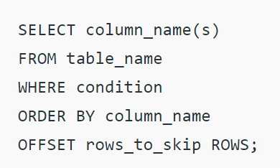
Syntax

Slide 4
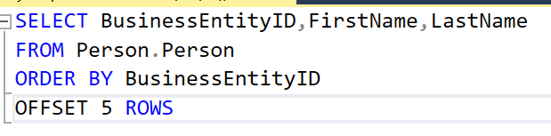
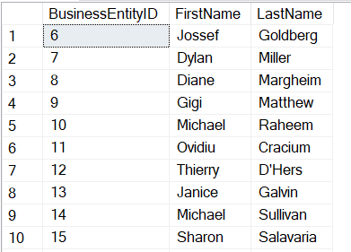
To show all but first 5 employees from Person.Person table

Slide 5
Fetch :
The FETCH argument is used to return a set of number of rows. FETCH can’t be used itself, it is used in conjunction with OFFSET.
The FETCH clause specifies the number of rows to return after the OFFSET clause has been processed. The value of offset is equal to or greater than one.

Slide 6
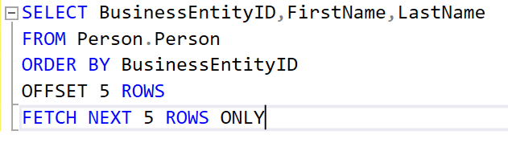
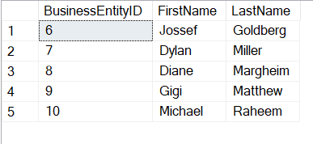
To show the next 5 records after the OFFSET

Slide 7
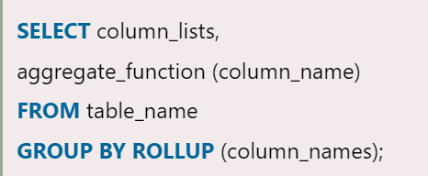
ROLLUP :
It is the subclass of the GROUP BY clause that performs an aggregate operation on multiple levels in a hierarchy and prepares summary reports. It allows to generate multiple grouping sets within a single query
Syntax:

Slide 8
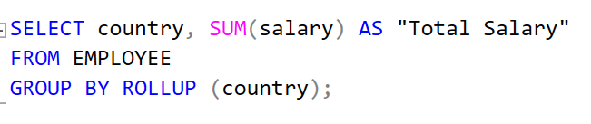
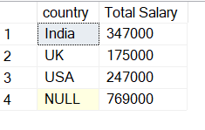
To return subtotal of salary grouped by country along with the grand total of salary

Slide 9
CUBE :
CUBE allows you to generate subtotals like the ROLLUP extension. In addition, the CUBE extension will generate subtotals for all combinations of grouping columns specified in the GROUP BY clause.

Slide 10
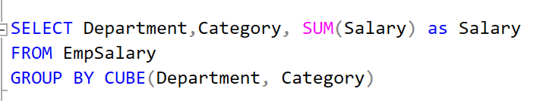
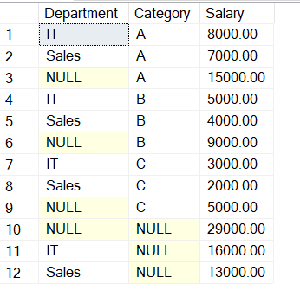
To show all of the combinations of Department and Category

Slide 11
Difference between ROLLUP & CUBE
There is only one major difference between the functionality of the ROLLUP operator and the CUBE operator. ROLLUP operator generates aggregated results for the selected columns in a hierarchical way. On the other hand, CUBE generates a aggregated result that contains all the possible combinations for the selected columns.

Slide 12

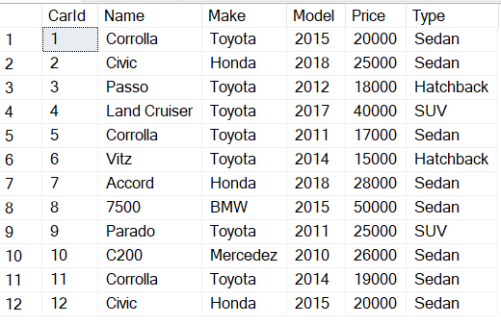
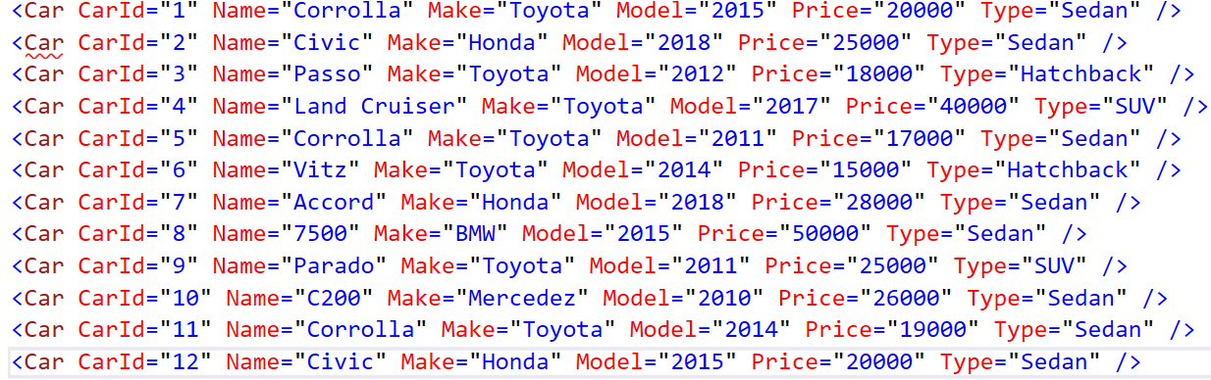
XML WITH MS SQL: Converting into XML from SQL tables
The FOR XML AUTO clause converts each column in the SQL table into an attribute in the corresponding XML document.

Slide 13
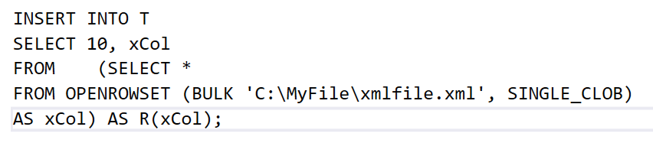
XML WITH MS SQL: Converting into SQL tables from XML
bulk load XML data into the server by using the bulk loading capabilities of SQL Server, such as bcp. OPENROWSET allows you to load data into an XML column from files.

Slide 14
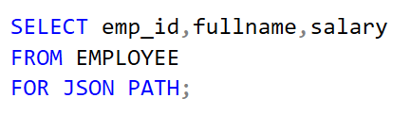
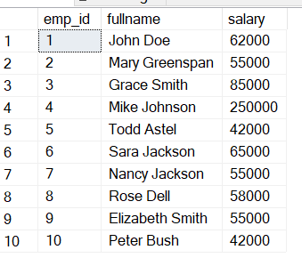
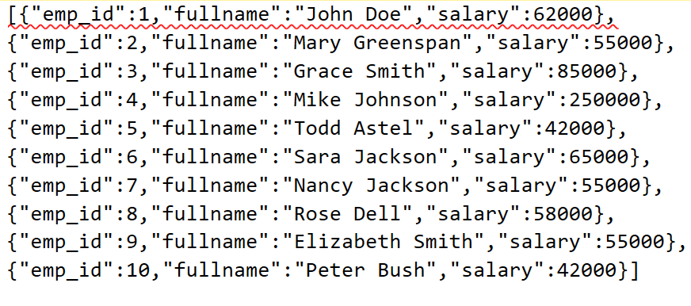
JSON WITH MS SQL: Converting into JSON from SQL tables
The FOR JSON clause formats SQL results as JSON text that can be provided to any app that understands JSON. The PATH option uses dot-separated aliases in the SELECT clause to nest objects in the query results.

Slide 15
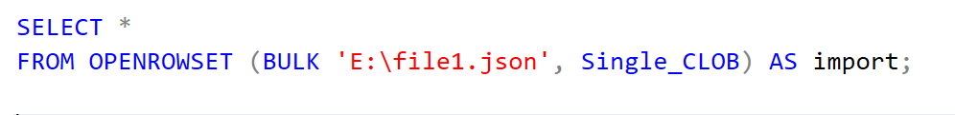
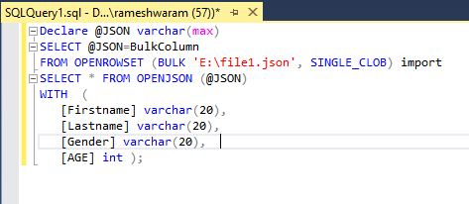
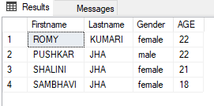
JSON WITH MS SQL: Converting into SQL tables from JSON
To load JSON data from an external service into SQL Server, you can use OPENJSON to import the data into SQL Server

